Slide 1
基本SQL SELECT语句
Notes:
Schedule: Timing Topic
40 minutes Lecture
25 minutes Practice
65 minutes Total

Slide 2
目标
通过本章学习，您将可以:
列举 SQL SELECT语句的功能。
执行简单的选择语句。
SQL 语言和 SQL*Plus 命令的不同。
Notes:
Lesson Aim
To extract data from the database, you need to use the structured query language (SQL) SELECT statement. You may need to restrict the columns that are displayed. This lesson describes all the SQL statements needed to perform these actions.
You may want to create SELECT statements that can be used more than once. This lesson also covers the iSQL*Plus environment where you execute SQL statements.
Note: iSQL*Plus is new in the Oracle9i product. It is a browser environment where you execute SQL commands. In prior releases of Oracle, SQL*Plus was the default environment where you executed SQL commands. SQL*Plus is still available and is described in Appendix C.

Slide 3
SQL语句分类
􀂃 Select查询语句
􀂃 DML语句（数据操作语言）
  Insert、Update、Delete、Merge
􀂃 DDL语句（数据定义语言）
  Create、Alter、Drop、Truncate
􀂃 DCL语句（数据控制语言）
  Grant、Revoke
􀂃 事务控制语句
  Commit 、Rollback、Savepoint

Slide 4
SQL SELECT 语句的功能
列
行
表
表
Join
表1
表2
Notes:
Capabilities of SQL SELECT Statements
A SELECT statement retrieves information from the database. Using a SELECT statement, you can do the following:
Projection: You can use the projection capability in SQL to choose the columns in a table that you want returned by your query. You can choose as few or as many columns of the table as you require.
Selection: You can use the selection capability in SQL to choose the rows in a table that you want returned by a query. You can use various criteria to restrict the rows that you see.
Joining: You can use the join capability in SQL to bring together data that is stored in different tables by creating a link between them. You learn more about joins in a later lesson.
Instructor Note
Inform students that selection and projection are often considered horizontal and vertical partitioning.

Slide 5
基本 SELECT 语句
SELECT *|{[DISTINCT] column|expression [alias],...}
FROM table;
SELECT 标识 选择哪些列。
FROM 标识从哪个表中选择。
Notes:
Basic SELECT Statement
In its simplest form, a SELECT statement must include the following:
A SELECT clause, which specifies the columns to be displayed
A FROM clause, which specifies the table containing the columns listed in the SELECT clause
In the syntax:
SELECT is a list of one or more columns
* selects all columns
DISTINCT suppresses duplicates
column|expression selects the named column or the expression
alias gives selected columns different headings
FROM table specifies the table containing the columns
Note: Throughout this course, the words keyword, clause, and statement are used as follows:
A keyword refers to an individual SQL element.
For example, SELECT and FROM are keywords.
A clause is a part of a SQL statement.
For example, SELECT employee_id, last_name, ... is a clause.
A statement is a combination of two or more clauses.
For example, SELECT * FROM employees is a SQL statement.

Slide 6
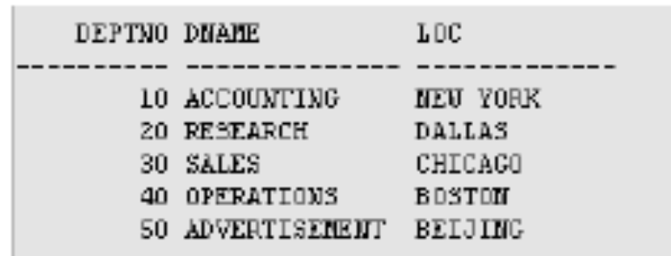

查询结果的默认显示效果
iSql*plus的默认显示
  列标题默认显示为大写
  列标题缺省居中对齐
SQL*Plus:
  字符和日期类型的列左对齐
  字符类型的列右对齐
  默认头显示方式:大写

Slide 7

选择全部列
SELECT *
FROM departments;
Notes:
Selecting All Columns of All Rows
You can display all columns of data in a table by following the SELECT keyword with an asterisk (*). In the example on the slide, the department table contains four columns: DEPARTMENT_ID, DEPARTMENT_NAME, MANAGER_ID, and LOCATION_ID. The table contains seven rows, one for each department.
You can also display all columns in the table by listing all the columns after the SELECT keyword. For example, the following SQL statement, like the example on the slide, displays all columns and all rows of the DEPARTMENTS table:
SELECT department_id, department_name, manager_id, location_id
FROM departments;
Instructor Note
Let the students know that details of all the tables are given in Appendix B.

Slide 8

选择特定的列
SELECT department_id, location_id
FROM departments;
Notes:
Selecting Specific Columns of All Rows
You can use the SELECT statement to display specific columns of the table by specifying the column names, separated by commas. The example on the slide displays all the department numbers and location numbers from the DEPARTMENTS table.
In the SELECT clause, specify the columns that you want, in the order in which you want them to appear in the output. For example, to display location before department number going from left to right, you use the following statement:
SELECT location_id, department_id
FROM departments;
Instructor Note
You can also select from pseudocolumns. A pseudocolumn behaves like a table column but is not actually stored in the table. You cannot insert or delete values of the pseudocolumns. Some available pseudocolumns are CURRVAL, NEXTVAL, LEVEL, ROWID, and ROWNUM.
…

Slide 9
Writing SQL Statements
SQL 语言大小写不敏感。
SQL 可以写在一行或者多行
关键字不能被缩写也不能分行
各子句一般要分行写。
使用缩进提高语句的可读性。
Notes:
Writing SQL Statements
Using the following simple rules and guidelines, you can construct valid statements that are both easy to read and easy to edit:
• SQL statements are not case sensitive, unless indicated.
SQL statements can be entered on one or many lines.
• Keywords cannot be split across lines or abbreviated.
Clauses are usually placed on separate lines for readability and ease of editing.
• Indents should be used to make code more readable.
Keywords typically are entered in uppercase; all other words, such as table names and columns, are entered in lowercase.
Executing SQL Statements
Using iSQL*Plus, click the Execute button to run the command or commands in the editing
window.
Instructor Note
Although not required in iSQL*Plus, placing a semicolon (;) at the end of the last clause is recommended. Other environments, such as PL/SQL programs, require that the end of each statement contains a semicolon.

Slide 10
算术运算符
数字和日期使用的数学表达式。
操作符
+
-
*
/
描述
加
减
乘
除
Notes:
Arithmetic Expressions
You may need to modify the way in which data is displayed, perform calculations, or look at what-if scenarios. These are all possible using arithmetic expressions. An arithmetic expression can contain column names, constant numeric values, and the arithmetic operators.
Arithmetic Operators
The slide lists the arithmetic operators available in SQL. You can use arithmetic operators in any clause of a SQL statement except in the FROM clause.
Instructor Note
You can use the addition and subtraction operators only with DATE and TIMESTAMP data types.

Slide 11


使用数学运算符
SELECT last_name, salary, salary + 300
FROM employees;
…
Notes:
Using Arithmetic Operators
The example in the slide uses the addition operator to calculate a salary increase of $300 for all employees and displays a new SALARY+300 column in the output.
Note that the resultant calculated column SALARY+300 is not a new column in the EMPLOYEES table; it is for display only. By default, the name of a new column comes from the calculation that generated it—in this case, salary+300.
Note: The Oracle9i server ignores blank spaces before and after the arithmetic operator.

Slide 12
操作符优先级
_
*
/
+
乘除的优先级高于加减。
同一优先级运算符从左向右执行。
括号内的运算先执行。
Notes:
Operator Precedence
If an arithmetic expression contains more than one operator, multiplication and division are evaluated first. If operators within an expression are of same priority, then evaluation is done from left to right.
You can use parentheses to force the expression within parentheses to be evaluated first.

Slide 13
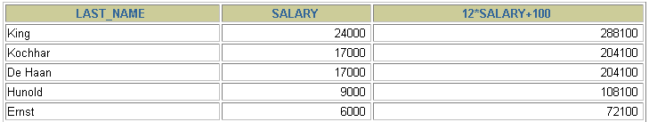

操作符优先级
SELECT last_name, salary, 12*salary+100
FROM employees;
…
Notes:
Operator Precedence (continued)
The example on the slide displays the last name, salary, and annual compensation of employees. It calculates the annual compensation as 12 multiplied by the monthly salary, plus a one-time bonus of $100. Notice that multiplication is performed before addition.
Note: Use parentheses to reinforce the standard order of precedence and to improve clarity. For example, the expression on the slide can be written as (12*salary)+100 with no change in the result.
Instructor Note
Demo: 1_prec1.sql, 1_prec2.sql
Purpose: To illustrate viewing a query containing no parentheses and executing a query with parentheses to override rules of precedence.

Slide 14
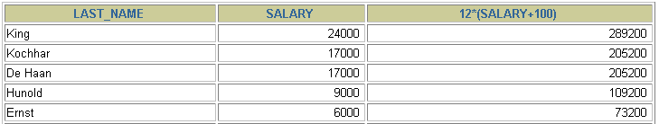

使用括号
SELECT last_name, salary, 12*(salary+100)
FROM employees;
…
Notes:
Using Parentheses
You can override the rules of precedence by using parentheses to specify the order in which operators are executed.
The example on the slide displays the last name, salary, and annual compensation of employees. It calculates the annual compensation as monthly salary plus a monthly bonus of $100, multiplied by 12. Because of the parentheses, addition takes priority over multiplication.

Slide 15
定义空值
空值是无效的，未指定的，未知的或不可预知的值。
空值不是空格或者0。
SELECT last_name, job_id, salary, commission_pct
FROM employees;
…
…
Notes:
Null Values
If a row lacks the data value for a particular column, that value is said to be null, or to contain a null.
A null is a value that is unavailable, unassigned, unknown, or inapplicable. A null is not the same as zero or a space. Zero is a number, and a space is a character.
Columns of any data type can contain nulls. However, some constraints, NOT NULL and PRIMARY KEY, prevent nulls from being used in the column.
In the COMMISSION_PCT column in the EMPLOYEES table, notice that only a sales manager or sales representative can earn a commission. Other employees are not entitled to earn commissions. A null represents that fact.
Instructor Note
Demo: 1_null.sql
Purpose: To illustrate calculating with null values.

Slide 16
空值在数学运算中的使用
包含空值的数学表达式的值都为空值
SELECT last_name, 12*salary*commission_pct
FROM employees;
…
…
Notes:
Null Values (continued)
If any column value in an arithmetic expression is null, the result is null. For example, if you attempt to perform division with zero, you get an error. However, if you divide a number by null, the result is a null or unknown.
In the example on the slide, employee King does not get any commission. Because the COMMISSION_PCT column in the arithmetic expression is null, the result is null.
For more information, see Oracle9i SQL Reference, “Basic Elements of SQL.”

Slide 17
列的别名
列的别名:
重命名一个列。
便于计算。
紧跟列名，也可以在列名和别名之间加入关键字‘AS’，以便在别名中包含空格或特殊的字符并区分大小写。
Notes:
Column Aliases
When displaying the result of a query, iSQL*Plus normally uses the name of the selected column as the column heading. This heading may not be descriptive and hence may be difficult to understand. You can change a column heading by using a column alias.
Specify the alias after the column in the SELECT list using a space as a separator. By default, alias headings appear in uppercase. If the alias contains spaces or special characters (such as # or $), or is case sensitive, enclose the alias in double quotation marks (" ").
Instructor Note
Within a SQL statement, a column alias can be used in both the SELECT clause and the ORDER BY clause. You cannot use column aliases in the WHERE clause. Both alias features comply with the ANSI SQL 92 standard.
Demo: 1_alias.sql
Purpose: To illustrate the use of aliases in expressions.

Slide 18


使用别名
SELECT last_name AS name, commission_pct comm
FROM employees;
…
SELECT last_name "Name", salary*12 "Annual Salary"
FROM employees;
…
Notes:
Column Aliases (continued)
The first example displays the names and the commission percentages of all the employees. Notice that the optional AS keyword has been used before the column alias name. The result of the query is the same whether the AS keyword is used or not. Also notice that the SQL statement has the column aliases, name and comm, in lowercase, whereas the result of the query displays the column headings in uppercase. As mentioned in a previous slide, column headings appear in uppercase by default.
The second example displays the last names and annual salaries of all the employees. Because Annual Salary contain a space, it has been enclosed in double quotation marks. Notice that the column heading in the output is exactly the same as the column alias.
Instructor Note
Point out the optional AS keyword in the first example and the double quotation marks in the second example. Also show that the aliases always appear in uppercase, unless enclosed within double quotation marks.

Slide 19
连接符
连接符:
把列与列，列与字符连接在一起。
用 ‘||’表示。
可以用来‘合成’列。
用法举例:
select ename || ' is a ' || job from emp;
select empno, ename || ' ''s annual salary is ' || sal*12 from emp;
Notes:
Concatenation Operator
You can link columns to other columns, arithmetic expressions, or constant values to create a character expression by using the concatenation operator (||). Columns on either side of the operator are combined to make a single output column.

Slide 20
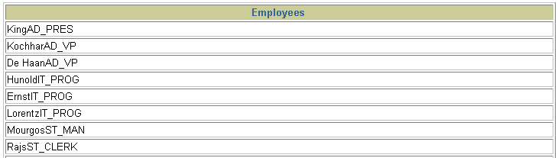
连接符应用举例
SELECT last_name||job_id AS "Employees"
FROM employees;
…
Notes:
Concatenation Operator (continued)
In the example, LAST_NAME and JOB_ID are concatenated, and they are given the alias Employees. Notice that the employee last name and job code are combined to make a single output column.
The AS keyword before the alias name makes the SELECT clause easier to read.

Slide 21
字符串
字符串可以是 SELECT 列表中的一个字符,数字,日期。
日期和字符只能在单引号中出现。
每当返回一行时，字符串被输出一次。
Notes:
Literal Character Strings
A literal is a character, a number, or a date that is included in the SELECT list and that is not a column name or a column alias. It is printed for each row returned. Literal strings of free-format text can be included in the query result and are treated the same as a column in the SELECT list.
Date and character literals must be enclosed within single quotation marks (' '); number literals need not.

Slide 22

字符串
SELECT last_name ||' is a '||job_id
AS "Employee Details"
FROM employees;
…
Notes:
Literal Character Strings (continued)
The example on the slide displays last names and job codes of all employees. The column has the heading Employee Details. Notice the spaces between the single quotation marks in the SELECT statement. The spaces improve the readability of the output.
In the following example, the last name and salary for each employee are concatenated with a literal to give the returned rows more meaning.
SELECT last_name ||': 1 Month salary = '||salary Monthly
FROM employees;
…

Slide 23
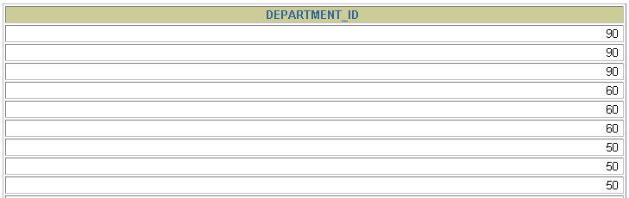
重复行
默认情况下，查询会返回全部行，包括重复行。
SELECT department_id
FROM employees;
…
Notes:
Duplicate Rows
Unless you indicate otherwise, iSQL*Plus displays the results of a query without eliminating duplicate rows. The example on the slide displays all the department numbers from the EMPLOYEES table. Notice that the department numbers are repeated.

Slide 24

删除重复行
在 SELECT 子句中使用关键字‘DISTINCT’删除重复行。
SELECT DISTINCT department_id
FROM employees;
Notes:
Duplicate Rows (continued)
To eliminate duplicate rows in the result, include the DISTINCT keyword in the SELECT clause immediately after the SELECT keyword. In the example on the slide, the EMPLOYEES table actually contains 20 rows but there are only seven unique department numbers in the table.
You can specify multiple columns after the DISTINCT qualifier. The DISTINCT qualifier affects all the selected columns, and the result is every distinct combination of the columns.
SELECT DISTINCT department_id, job_id
FROM employees;
…

Slide 25
SQL 和 SQL*Plus
SQL 语句
SQL*Plus
浏览器
Oracle
服务器
SQL*Plus
命令
查询结果
格式化报表
客户端
Notes:
SQL and iSQL*Plus
SQL is a command language for communication with the Oracle server from any tool or application. Oracle SQL contains many extensions.
iSQL*Plus is an Oracle tool that recognizes and submits SQL statements to the Oracle server for execution and contains its own command language.
Features of SQL
Can be used by a range of users, including those with little or no programming experience
Is a nonprocedural language
Reduces the amount of time required for creating and maintaining systems
Is an English-like language
Features of iSQL*Plus
Accessed from a browser
Accepts ad hoc entry of statements
Provides online editing for modifying SQL statements
Controls environmental settings
Formats query results into a basic report
Accesses local and remote databases

Slide 26
SQL 语句与
SQL*Plus 命令
SQL
  一种语言
  ANSI 标准
  关键字不能缩写
  使用语句控制数据库中的表的定义信息和表中的数据
SQL*Plus
  一种环境
  Oracle 的特性之一
  关键字可以缩写
  命令不能改变数据库中的数据的值
  集中运行
SQL
statements
SQL*Plus
commands
Notes:
SQL and iSQL*Plus (continued)
The following table compares SQL and iSQL*Plus:

Slide 27
SQL*Plus
使用SQL*Plus可以:
描述表结构。
编辑 SQL 语句。
执行 SQL语句。
将 SQL 保存在文件中并将SQL语句执行结果保存在文件中。
在保存的文件中执行语句。
将文本文件装入 SQL*Plus编辑窗口。
Notes:
iSQL*Plus
iSQL*Plus is an environment in which you can do the following:
Execute SQL statements to retrieve, modify, add, and remove data from the database
Format, perform calculations on, store, and print query results in the form of reports
Create script files to store SQL statements for repetitive use in the future
iSQL*Plus commands can be divided into the following main categories:

Slide 28
显示表结构
使用 DESCRIBE 命令，表示表结构
DESC[RIBE] tablename
Notes:
Displaying the Table Structure
In iSQL*Plus, you can display the structure of a table using the DESCRIBE command. The command shows the column names and data types, as well as whether a column must contain data.
In the syntax:
tablename is the name of any existing table, view, or synonym accessible to the user

Slide 29

显示表结构
DESCRIBE employees
Notes:
Displaying the Table Structure (continued)
The example on the slide displays the information about the structure of the DEPARTMENTS table.
In the result:
Null? indicates whether a column must contain data; NOT NULL indicates that a column must contain data
Type displays the data type for a column
The data types are described in the following table:
Instructor Note
Inform students that the column sequence in DESCRIBE tablename is the same as that in SELECT * FROM tablename . The order in which the columns are displayed is determined when the table is created.

Slide 30
总结
通过本课，您应该可以完成:
书写SELECT语句:
  返回表中的全部数据。
  返回表中指定列的数据。
  使用别名。
使用 SQL*Plus 环境，书写，保存和执行 SQL 语句和 SQL*Plus 命令。
SELECT *|{[DISTINCT] column|expression [alias],...}
FROM table;
Notes:
SELECT Statement
In this lesson, you should have learned about retrieving data from a database table with the SELECT statement.
SELECT *|{[DISTINCT] column [alias],...}
FROM table;
In the syntax:
SELECT is a list of one or more columns
* selects all columns
DISTINCT suppresses duplicates
column|expression selects the named column or the expression
alias gives selected columns different headings
FROM table specifies the table containing the columns
iSQL*Plus
iSQL*Plus is an execution environment that you can use to send SQL statements to the database server and to edit and save SQL statements. Statements can be executed from the SQL prompt or from a script file.
Note: The SQL*Plus environment is covered in Appendix C.

